Slide 1
Integrated Coastal Zone Management
Unit 5: Problem tree analysis

Slide 2
Introduction
Unit content
Identifying and ranking local coastal threats
Understanding different perceptions of threats
Problem trees and their use
Comparing different stakeholders’ problem trees
Learning outcomes
Upon completion of this unit, students will be able to
Justify and explain their perception of domestic coastal threats
Be aware that different stakeholders perceive different threats
Understand how a problem tree is constructed
Use problem trees to compare stakeholder views

Slide 3
Local coastal threats
Task:
In your view, what are the most important threats to the coastal zone in this country?
based on your own knowledge, experience or memory
can be local, regional or national scale, but must be domestic coastal zone: not overseas

Slide 4
Local coastal threats
Task:
In your view, what are the most important threats to the coastal zone in this country?
based on your own knowledge, experience or memory
can be local, regional or national scale, but must be domestic coastal zone: not overseas
How do these perceived threats vary within the group and what are the implications?
Individual perceptions reflect our own experience
Priority threats reflect our individual assumptions about the environment

Slide 5
Perceptions of threats
Task:
In your view, what are the most important threats to the coastal zone in this country?
based on your own knowledge, experience or memory
can be local, regional or national scale, but must be domestic coastal zone: not overseas
How do these perceived threats vary within the group and what are the implications?
Individual perceptions reflect our own experience
Priority threats reflect our individual assumptions about the environment
Can we try and imagine how others see the coast?
What would be the priority needs of a company wanting to establish an oil palm plantation?
What would they want from coastal managers?

Slide 6
Perceptions of threats
Small group work:
Group 1: tourism operator
Group 2: urban developer
Group 3: conservation NGO
What are the top three coastal problems of concern to each group?
What does this tell us about the perceptions, needs and priorities of different stakeholder groups?

Slide 7
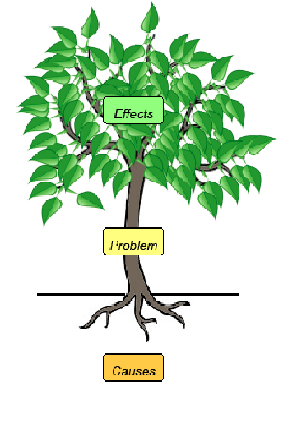
Problem trees
A method to identify cause and effect in environmental problems

Slide 8
Problem trees
A method to identify cause and effect in environmental problems
The effects are the leaves and branches of the tree.
The problem is the trunk of the tree.
The causes of the problem are the roots of the tree.

Slide 9
Problem trees
Fishers’ perceptions of effects of declining fish abundance
What are the main effects of concern to local fishers?
- produce a list
DECLINING FISH ABUNDANCE

Slide 10
Problem trees
Fishers’ perceptions of effects of declining fish abundance
EFFECTS
Declining catches
Greater fuel expense
Inability to feed families
Growing debts
Lack of alternative occupations
Inability to invest in fishing equipment
Possible loss of fishing grounds
DECLINING FISH ABUNDANCE

Slide 11
Problem trees
Fishers’ perceptions of causes of declining fish abundance
DECLINING FISH ABUNDANCE
What do fishers see as the main causes of declining fish abundance?
- produce a list

Slide 12
Problem trees
Fishers’ perceptions of causes of declining fish abundance
DECLINING FISH ABUNDANCE
CAUSES
Too many fishermen
Outside fishermen
Destructive fishing
Possession of fishing technology (eg sonar)
UNDERLYING CAUSES
Local population growth
Migration to coastal areas
New overseas markets for fish

Slide 13
Problem trees
Fishers’ perceptions of cause and effect of declining fish abundance
EFFECTS
Declining catches
Greater fuel expense
Inability to feed families
Growing debts
Lack of alternative occupations
Inability to invest in fishing equipment
Possible loss of fishing grounds
DECLINING FISH ABUNDANCE
CAUSES
Too many fishermen
Outside fishermen
Destructive fishing
Possession of fishing technology (eg sonar)
UNDERLYING CAUSES
Local population growth
Migration to coastal areas
New overseas markets for fish

Slide 14
Comparing problem trees
Small group task
you are an offshore oil and gas development company
your main problem is ‘A lack of information regarding offshore oil and gas deposits’
Construct a problem tree
What are the causes of the problem
What are the effects of the problem
Lack of information regarding offshore oil and gas deposits

Slide 15
Comparing problem trees
Small group task
you are an offshore oil and gas development company
your main problem is ‘A lack of information regarding offshore oil and gas deposits’
Construct a problem tree
What are the causes of the problem
What are the effects of the problem
The coastal manager has to try and combine all stakeholders’ perceived problems and their opinions on causes and effects
Integrated coastal zone management involves conflict resolution and trade-offs in decision making
Lack of information regarding offshore oil and gas deposits

